Slide 1


AMM DEX Liquidity Pool
AMM DEX Liquidity Pool
AMM DEX Liquidity Pool
Swap with me.
Any wallet.
Any time.
Any place
[with an internet connection].
Any asset
[from liquidity providers].
Bonding Curve AMM:
X*Y=K

Slide 2
Liquidity Pool Theory
A medium which holds goods that can be swapped
Blockchains use smart contracts for liquidity pools:
  to hold assets (balances)
  to control the flow of assets (transactions [smart contract data] )
    liquidity pools can generate yield for liquidity providers based on swap fees.
      0.3% fee swap with for a Liquidity Provider [same fee as Uniswap]:
      Step 1. require(msg.sender == (swapCost*1003)/1000) )
      Step 2. payable(LiquidityProvider).transfer(((swapCost*3)/1000))
    We will keep it simple and just make a fair trade liquidity pool (fee = 0%).
Liquidity pools generally follow the constant product model:
Supply_A * Supply_B = Constant_product

Slide 3

Viewing Blockchain Liquidity Pools
Blockchain explorers like Etherscan make it easy to review swaps and balances for traders and smart contract liquidity pools.

Slide 4
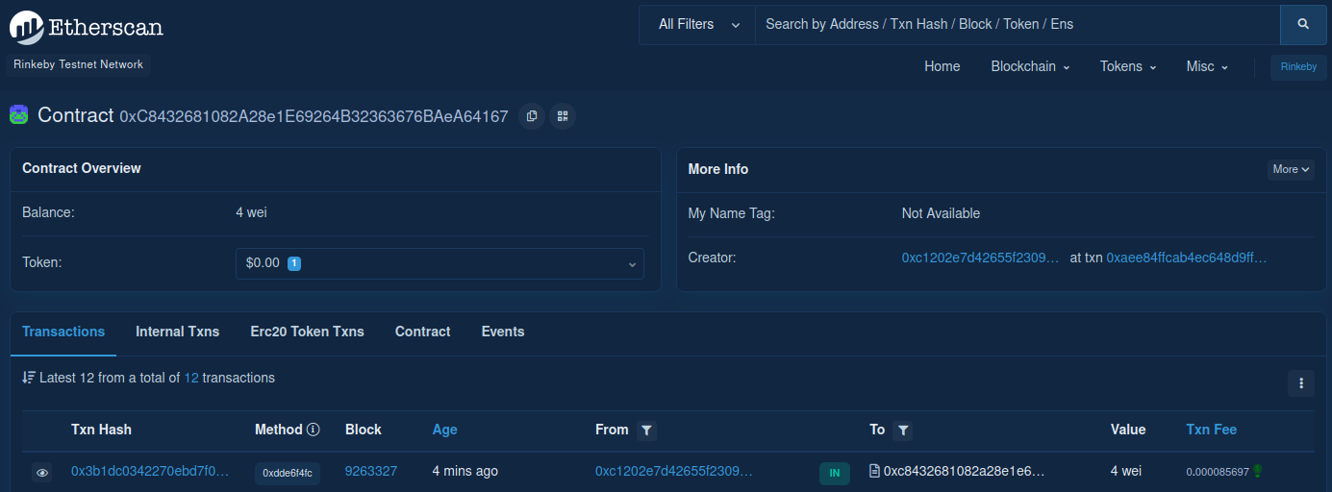
Liquidity Pool Ethereum Balance

Slide 5
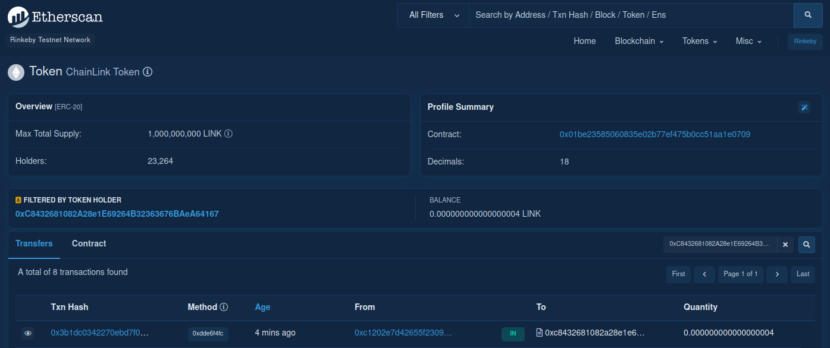
Token Liquidity Pool Balance

Slide 6


DEX
DEX [Decentralized exchange] – a smart contract based swap platform that makes accessing liquidity pools from a front end website easy with blockchain wallets

Slide 7

Metamask
A popular Ethereum wallet for your blockchain:
  -Address (for storing funds)
  -Private key (for authorizing transactions from your address)
  -Seed phrase (used to recover the private key for a certain address)
Acts as an internet browser extension for desktop and mobile devices
Is a “hot wallet” (private key stored on device with internet), but you can import a “cold wallet” (private key on hardware isolated from the internet) and use Metamask more securely

Slide 8
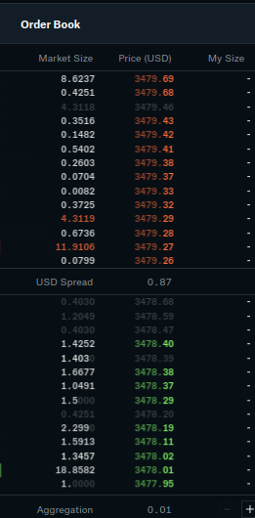
AMM
AMM [Automated Market Maker]
a mechanism for pricing goods for
swaps [Example: constant product
for bonding curve equation]
Example of traditional
market maker: order book
[buy (demand) and sell (supply)
orders for a good impacts price]

